Slide 1

Chapter 12: Software Support and Maintenance
Notes:
Title: deleted underline under colon

Slide 2
Product Released!
Software
released!
Now what?

Slide 3
Customer/User Support
Post software product-release support
Non-defect support
Usage questions/answers
General help (install, recovery, etc.)
Additional and supplemental functions (future releases)
Defect support
Report and track failure and defect
Recovery from failure
Work around
Fixes releases

Slide 4
Defect Support
While both non-defect and defect support are important, defect support requires some sophistication:
Project the # of problems and problem arrival rate.
Estimate and plan the needed support resources.
Educate and build the defect support team.
Defect reporting and tracking.
Defect identification, fix, and release.

Slide 5
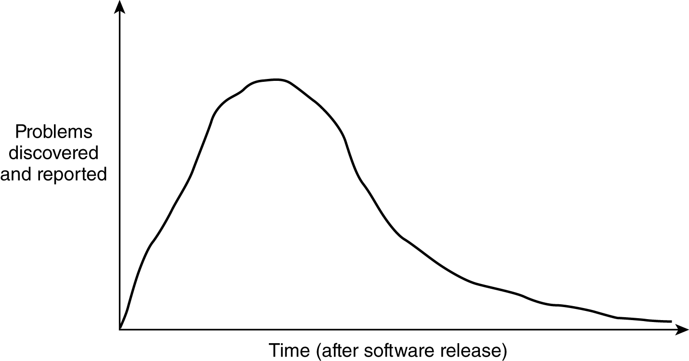
Problem Arrival Curve
− During the period right after
release, many problems are
discovered and reported.
− The amount of problems discovered
eventually decreases; at the same
time the nature of the problem
discovered becomes more difficult
to diagnose.

Slide 6
Problem Discovery Curve
Traditionally follow a Rayleigh curve:
A special case of Weibull distribution:
f(t) = (m/t) (t/c)^{m} e ^{(−t/c)m}
[ note: m is a superscript to (−t/c) ]
when m = 2, we have Rayleigh curve
f(t) = (2/t) (t/c)² e^{(−t/c)2}

Slide 7
Customer Support
Software support is not free.
Most charge an annual fee (e.g., 18% of product).
Software support is not forever.
Most product goes through a number of releases.
Each product release is only supported for a limited number of years.
Customers/users are moved from back-level software to the current release as soon as possible.
Usually support no more than two back levels of a software

Slide 8
Product Support Life Cycle
Non-defect support
User/customer
migration
Plan & prepare for
support/maintenance
Defect support
Reduced defect support
(only severe defects)
Product
release
Announcement
of new release or replacement
software
Product
withdrawal

Slide 9
Product “Sunsetting”
Stop any product’s additional feature and enhancement.
Fix only the high severity problems.
Announce new replacement product.
Encourage new and existing customers to move to new product.
Notify all old users of the old product of the planned termination date.
Provide names of other vendors who are willing to support the old product to the customers who choose to stay.
Terminate the customer product and withdraw the product from market.

Slide 10
Tiered Customer Support
Organize the support group into tiers:
A direct customer contact tier to accept problems, prioritize problems, record problems, solve “easy” problems, and manage the problem-resolution cycle.
A higher tier of specialized resource that sometimes talks to customers to resolve more difficult problems with workarounds
A tier of experts that can fix and rebuild the code
May be
one
tier

Slide 11
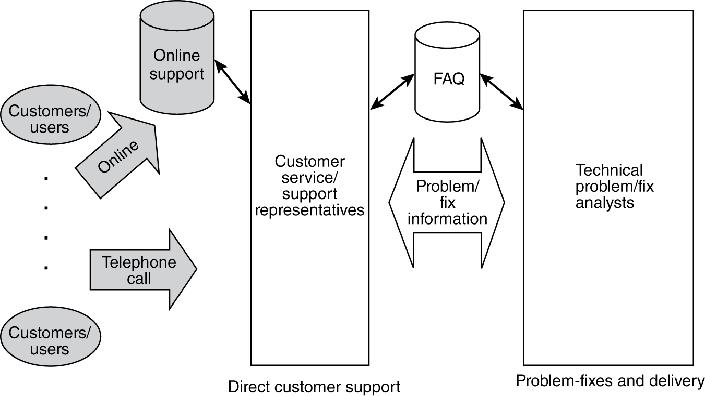
A Sample Service and Support Organization

Slide 12
Problem Fixes
A key parameter in keeping customers satisfied is to turn the problem fixes around within some reasonable time frame.
This requires an understanding and a “contract” of service terms.
The contract on fix response time is in turn dependent on the types of problem based on some “prioritization” scheme.

Slide 13
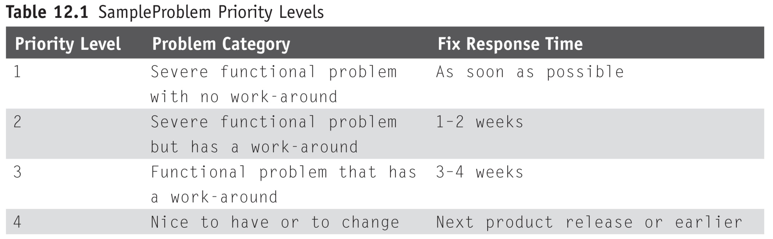
Sample Problem Priority Levels

Slide 14
Installing Fixes
Customers do not always install a fix release provided by the software support group.
Choose and pick the fixes they want.
Modified code and cannot apply the generic fix release.
Stay on some past release because it “finally” works.
Need to explain the potential serious problem.
Fix release related to other fix releases that customers care about in product fix situation (see next slide).
A released fix may have reworked over a previous “emergency’ fix code area (see a later slide).

Slide 15
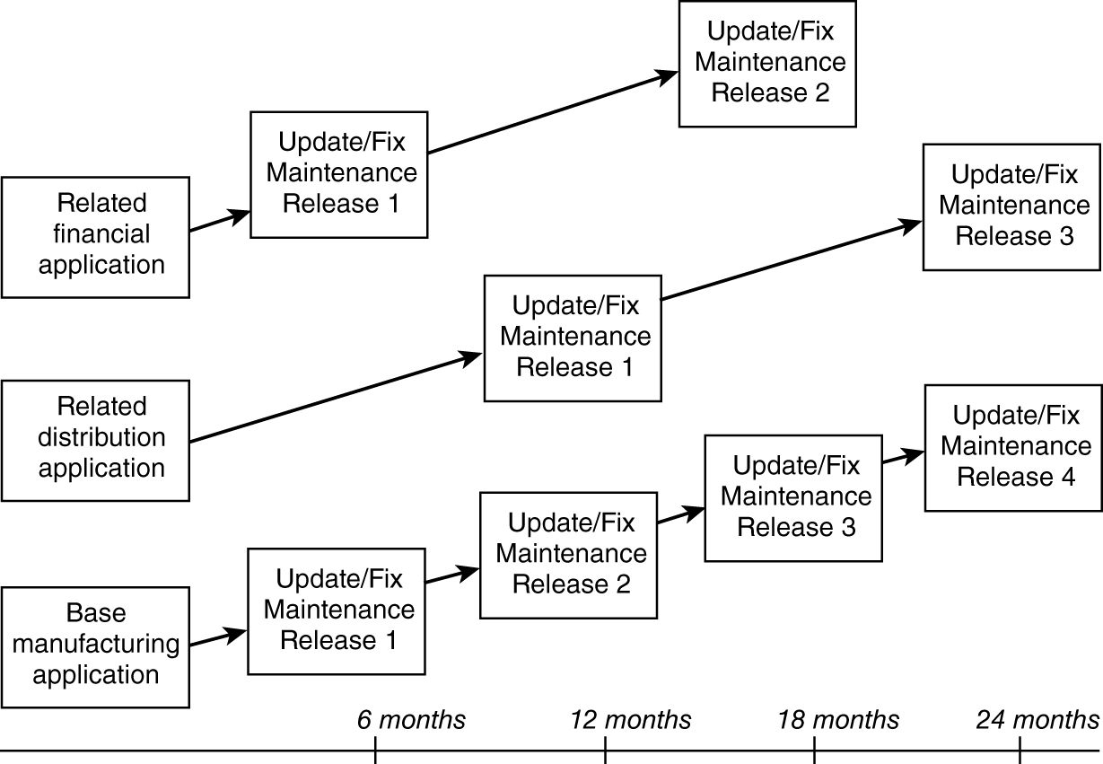
Multiple product fix releases that must be applied together to keep all the functions and data in sync

Slide 16
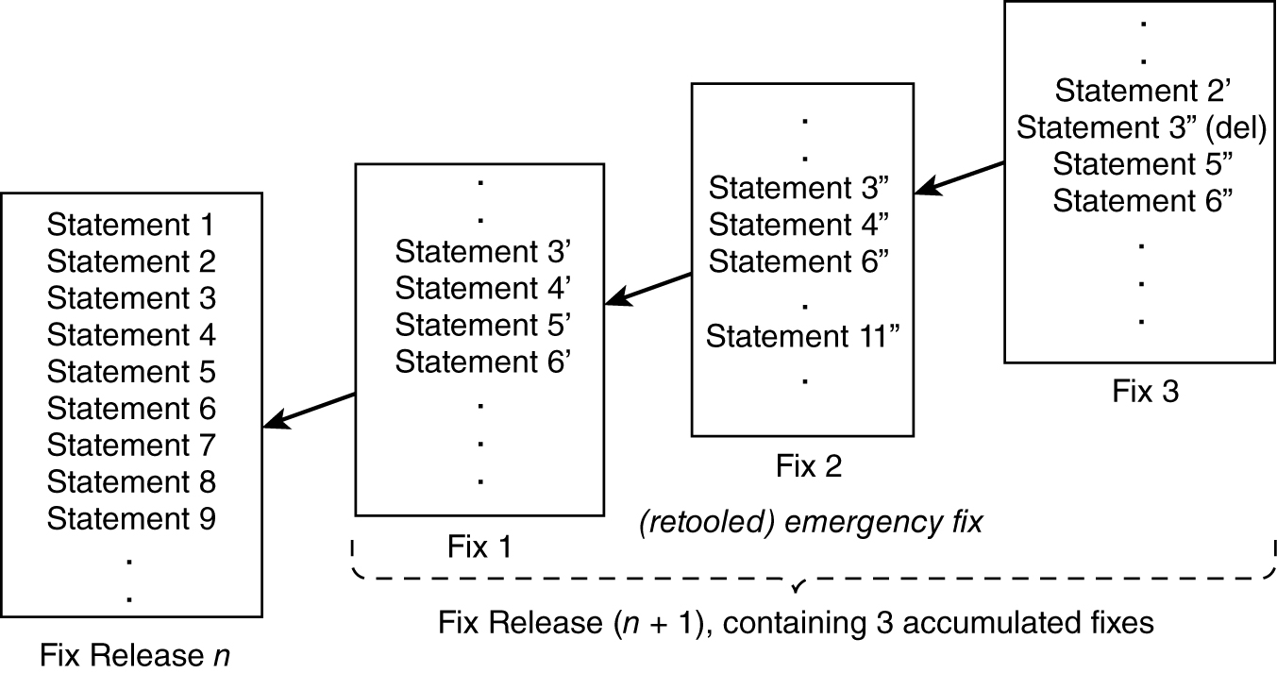
Fix Overlay Problem

Slide 17
Fix Install
Users and customers should be encouraged to install the latest fix release and install the fix releases in sequence.
Sometimes they need a better explanation than “it is our policy.”

Slide 18
Change Control in Support & Maintenance
All problems reported need to be tracked through successful problem resolution with the customers.
A part of this control is to ensure that all changes, for fixes and for enhancements, are not arbitrary and capricious.
Change control is the mechanism used, just as in software development prior to release, to ensure that all changes are managed through
Change control process
Documented changes (change control form as an aid)
Change control committee

Slide 19
Change Control Process and Committee
Manages the changes via a work flow:
Origination of change request
Approval of change request
Monitoring the changes being made
Closing the completed change
Needs resource to ensure the control process:
Change control board or committee
Automated workflow tool (using a change control form)

Slide 20
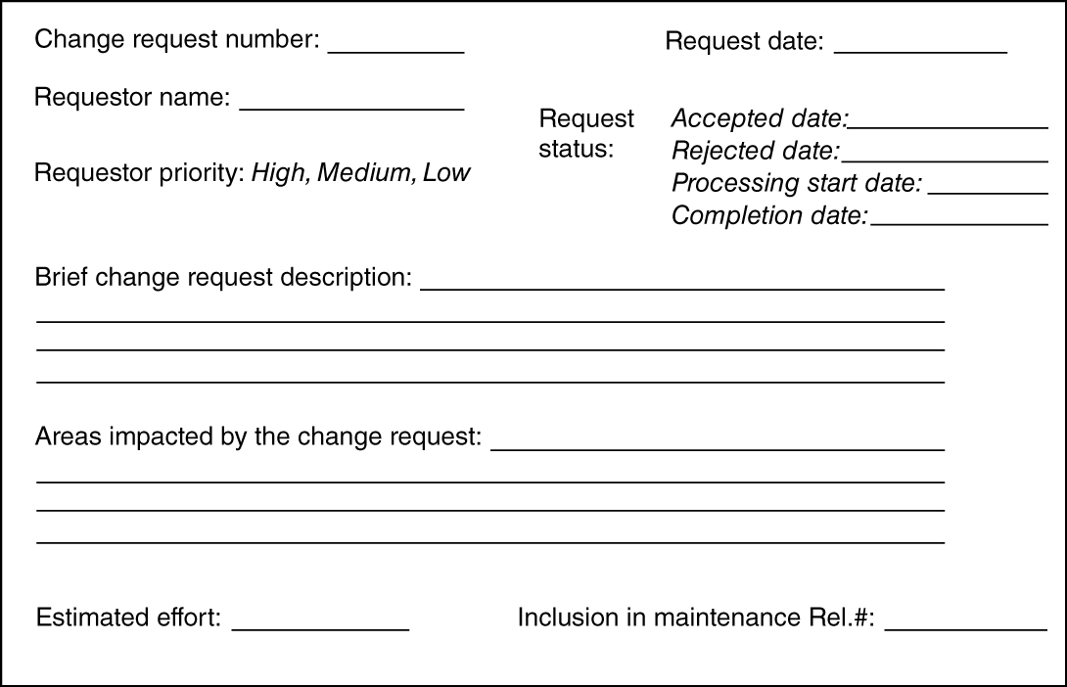
Sample Maintenance Change Request Form

